Slide 1
STUDYING FRENCH
AT GCSE

Slide 2
Why choose French?
Your son/daughter has already built a secure foundation studying French in Years 8-10 in Key Stage 3.
A GCSE in French helps students to:
• develop their knowledge of and enthusiasm for language learning skills by providing opportunities for the practical use of French
• develop the confidence to communicate effectively in French;
raise your awareness and widening your understanding of French-speaking countries/communities and;
• take their place as citizens in a multilingual, global society.

Slide 3
What TOPICS will I study?
Topics are relevant, interesting and similar to those studied at Key Stage 3.
You will study 3 different Contexts over the two years:
Identity, Lifestyle and Culture
Local, National, International and Global Areas of Interest
School Life, Studies and The World of Work

Slide 4
Context 1: Identity, Lifestyle and Culture
Myself, my family, relationships and choices [e.g. family and friends]
Social media and new technology [e.g. online communications, computers, tablets and smartphones]
Free time, leisure and daily routine [e.g. hobbies, cinema, TV, music, dance, fashion, eating out, shopping, at home, at school and at the weekend]
Culture, customs, festivals and celebrations [e.g. Easter, Christmas, birthdays, cultural activities and events, national holidays, celebrations and cuisine]

Slide 5
Context 2: Local, National, International and Global Areas of Interest
My local area and the wider environment [e.g. home, neighbourhood, town or city, places to visit, region and country]
Community involvement [e.g. charity and voluntary work]
Social and global issues [e.g. health, lifestyle, anti-social behaviour, caring for others and caring for the environment]
Travel and tourism [e.g. holidays, destinations, transport, tourist information, weather, directions, accommodation, activities, shopping and eating out]

Slide 6
Context 3: School Life, Studies and The World of Work
My studies and school life [e.g. school subjects, uniform, timetable, rules and regulations]
Extra-curricular activities [e.g. clubs, societies, events, trips and visits]
Part-time jobs and money management [e.g. evening work, weekend work and work experience]
Future plans and career [e.g. further studies, employment, aspirations and choices]

Slide 7
What WILL MY EXAMS BE LIKE?
All French examinations will take place at the end of Year 12.
They will cover all work carried out in both Years 11 and 12.
You will sit 4 separate examinations, each testing a different linguistic skill; listening, speaking, reading and writing
Each unit (listening, speaking, reading and writing) is worth 25% of overall grade
You can tailor your exam to your needs, i.e. you can either sit all Foundation/Higher in each skill or you can sit Foundation tier in one examination and Higher tier in another.

Slide 8
Unit 1: listening
External written examination
Test lasts approximately:
35 minutes at Foundation Tier; and
45 minutes at Higher Tier.
You will answer twelve questions, in English and French.

Slide 9
Unit 2: speaking
Teacher-conducted speaking examination
Lasts 7–12 minutes (plus 10 minutes of preparation time)
Students complete two role-plays and a general conversation on two topics in French.
Students are told the first topic of conversation to allow them to thoroughly prepare in advance

Slide 10
Unit 3: reading
External written examination
50 minutes at Foundation Tier
1 hour at Higher Tier
Students answer a variety of questions in English and in French, as well as translating short sentences from French into English

Slide 11
Unit 3: WRITing
External written examination
1 hour at Foundation Tier
1 hour 15 minutes at Higher Tier
Students answer four questions including listing (at Foundation Tier), short phrase/sentence responses, translating short sentences, and one extended writing task (from a choice of three) in French

Slide 12
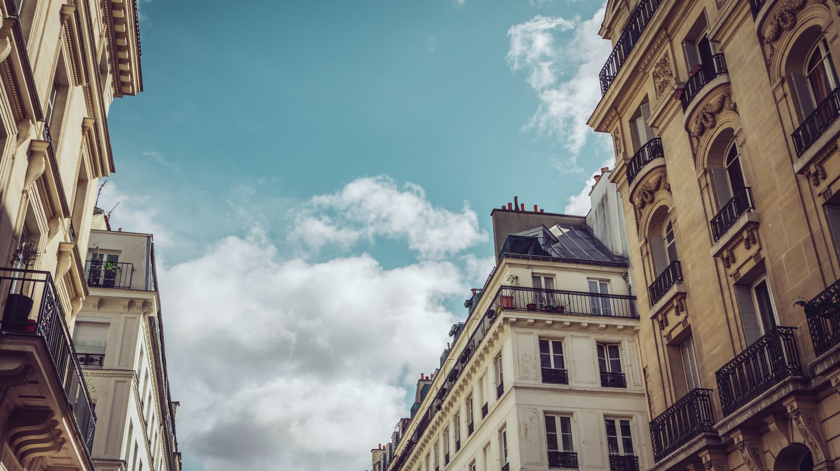
PARIS TRIP 2023
Promoting Modern Languages in St. Louis, be it French, Irish or Spanish, is for us an exceptional and crucial way to emphasize the importance of languages and to encourage our students to celebrate cultural diversity and inclusion in society. It opens the minds of our students, making languages real and allows them to appreciate languages from another dimension.

Slide 13
25th-28th June 2023 marked a spectacular school trip with 52 students and 5 teachers taking to the skies of France embarking on a jam-packed four-day break. Our trip began at the ‘Tour Eiffel’ and The ‘Arc de Triomphe’ where students were able to soak up the atmosphere at their leisure in the most iconic French capital, then travelling down the ‘Champs Elysées’, known for being the most famous avenue in the world.
We then dived deeper into Parisian culture ascending up the steep staircase of 270 steps to ‘Sacre Coeur’ at Montmartre, each step softly smoothed out from the footsteps of millions of sight-seers each year. We eventually found ourselves at the summit surrounded by quaint delicatessens and restaurants. While enjoying every sumptuous mouthful, in what was a remarkable blend of gastronomic delights of frog’s legs, snails and onion soup, we could not help but notice a vast array of friendly artists, who were very carefully depicting the portraits of their ever-so-still models.

Slide 14
The ‘Stade de France’ was our next visit. The football fans and concert goers among our staff and students thoroughly enjoyed this stop. Following this we made our way down Seine, relishing in a fabulous sun-soaked, open-top river cruise, learning many facts about buildings and artefacts along the way. We were grateful to have received a highly-educational, private bus tour of the capital allowing us to appreciate the many different historical figures in French history. We also remembered Princess Diana while luckily catching a glimpse of her memorial flame and passing Napoleon’s tomb in the very prestigious ‘Hôtel des Invalides’.
Students then spent the last day in Disneyland enjoying the magical world of Disney and seeking to find adventure and thrill from the many rollercoasters and fun-filled theme park rides. We couldn’t finish our school trip without visiting The ‘Louvre’; one of the largest, oldest and grandest museums in the world! We followed this by ascending the ‘Tour de Montparnasse’ where students were able to experience panoramic views of the whole Parisian city as far as the eye could see!
Enjoy our photos! ☺

Slide 15
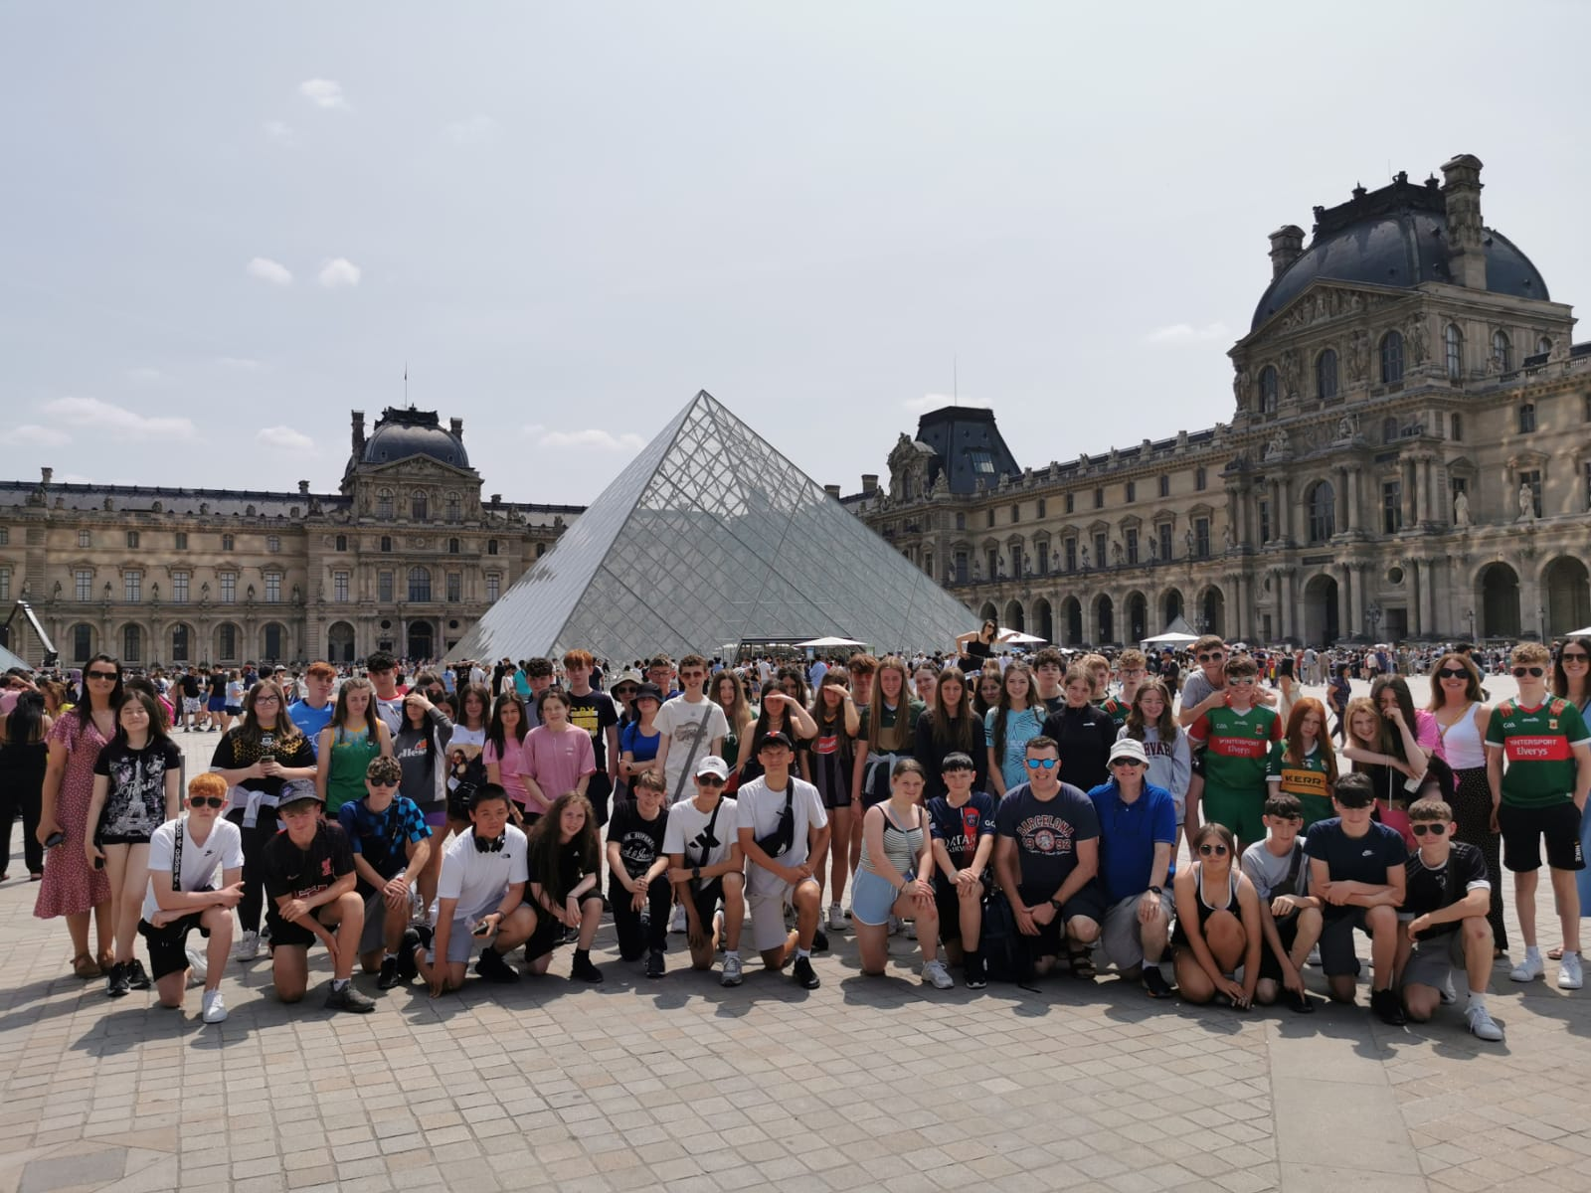

Slide 16
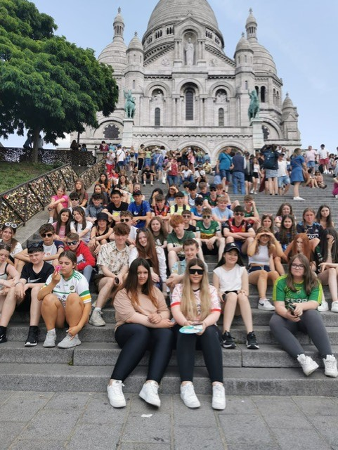

Slide 17
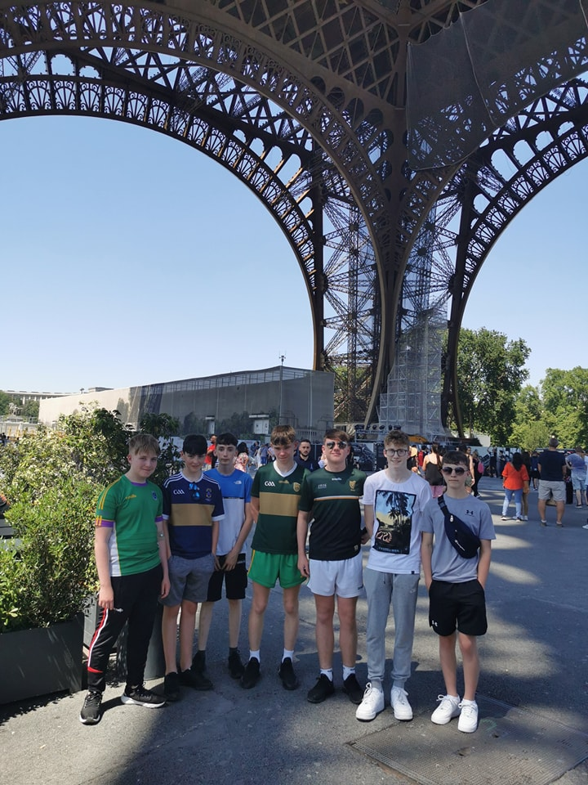

Slide 18
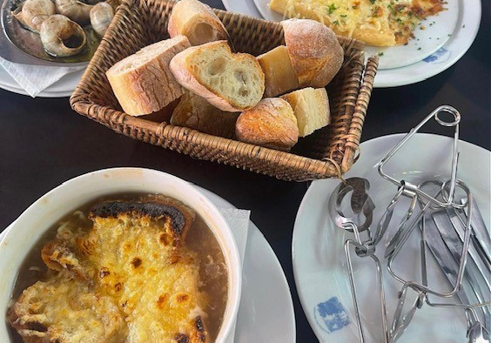
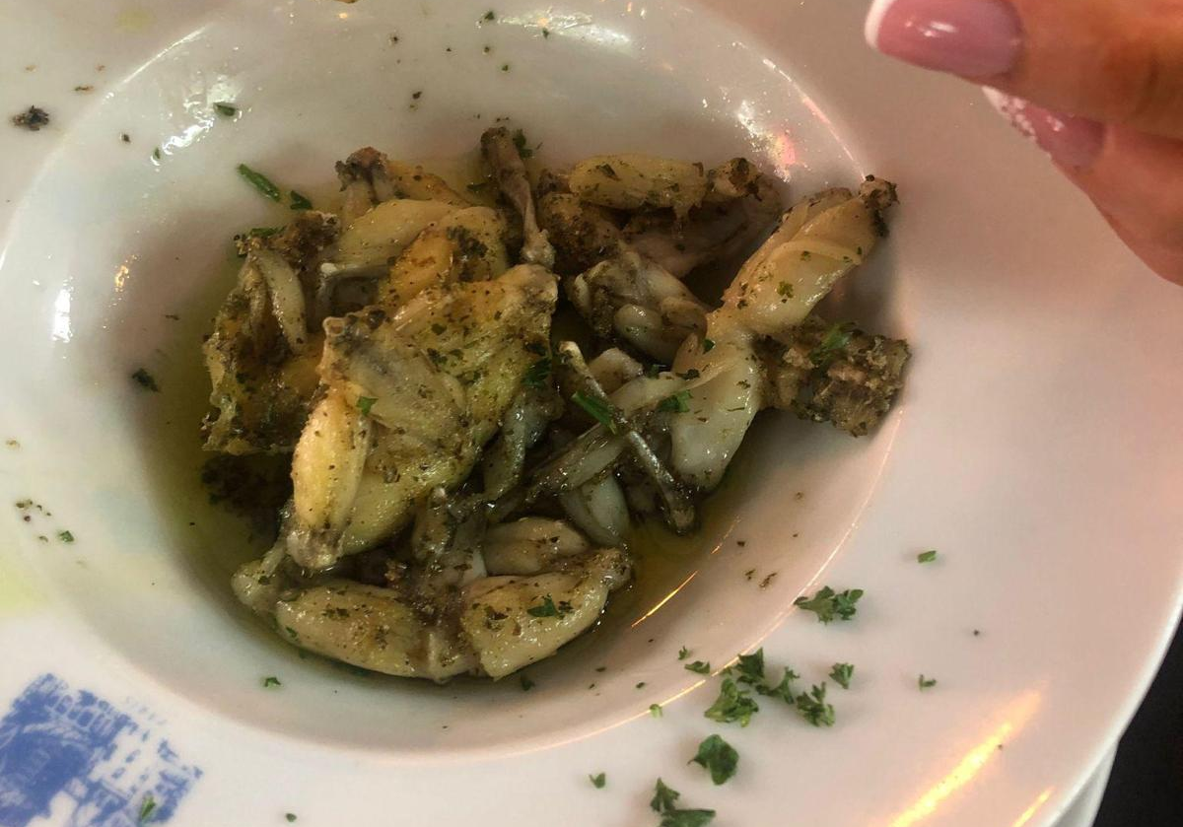

Slide 19
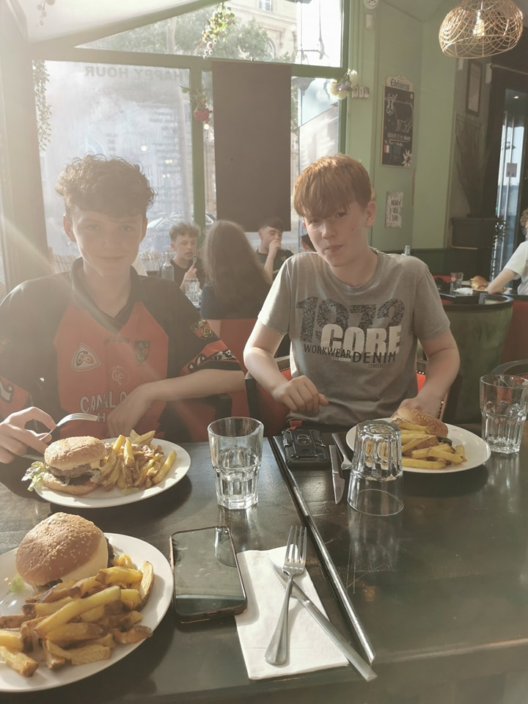

Slide 20
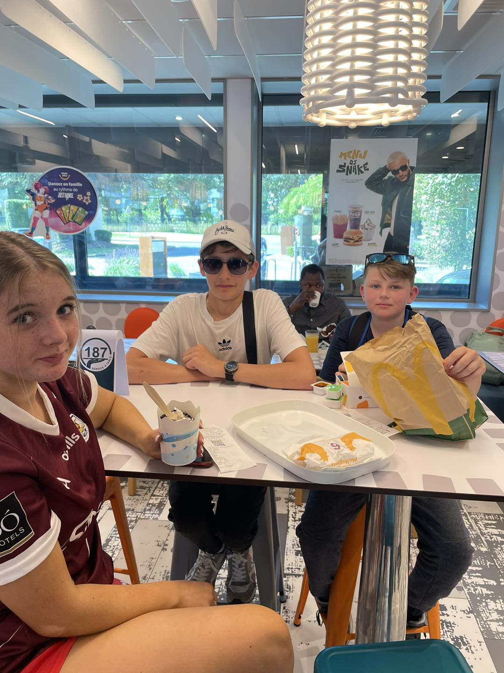
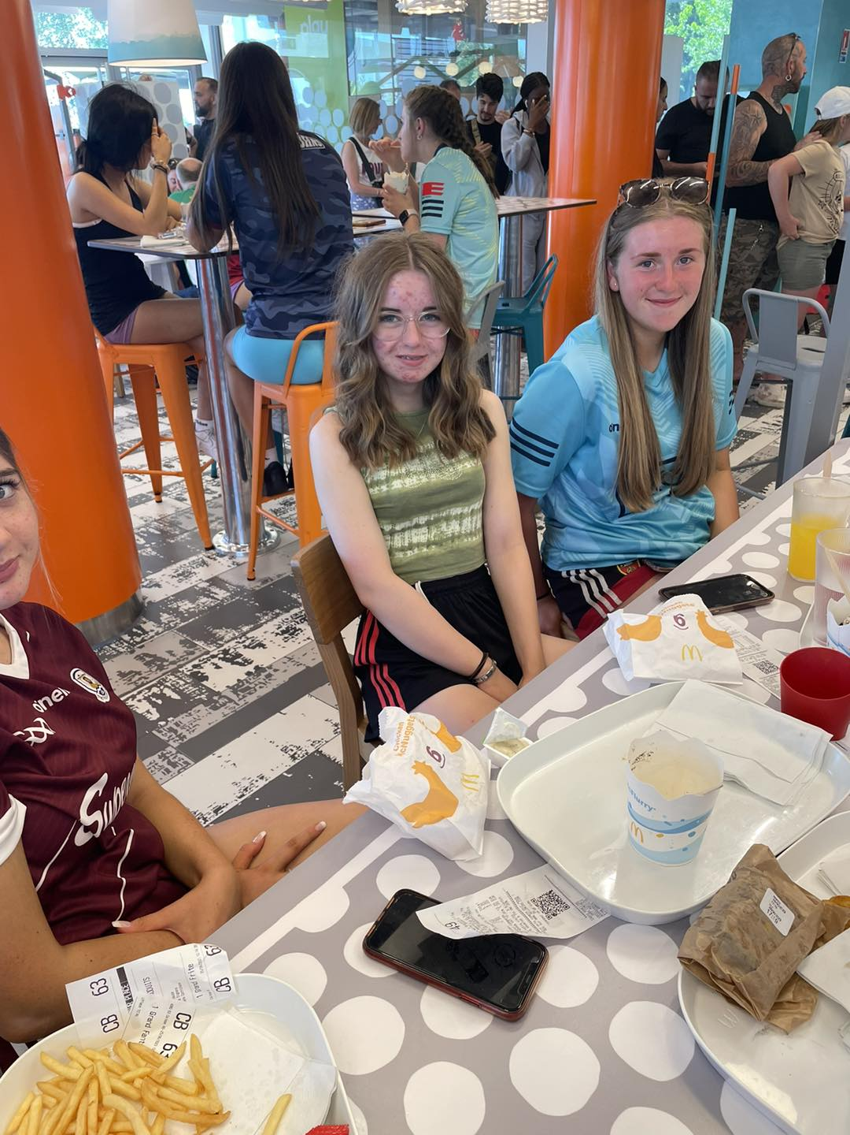
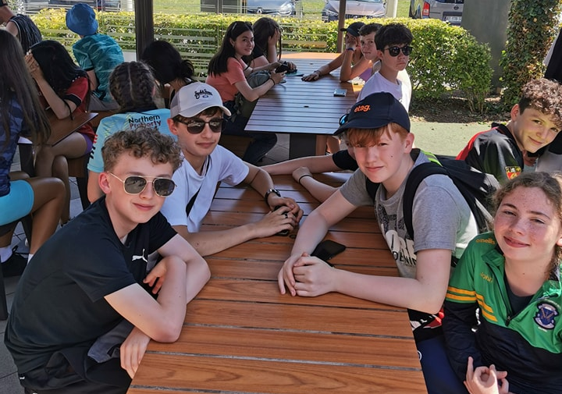

Slide 21
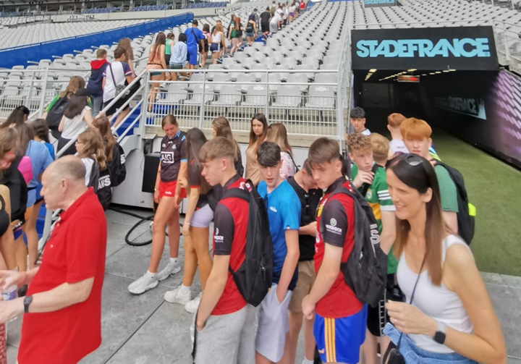
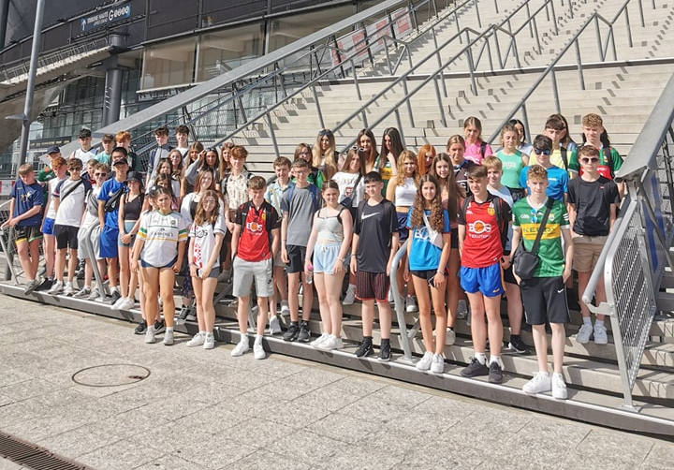

Slide 22
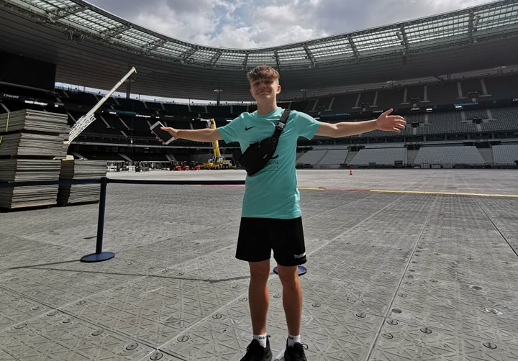
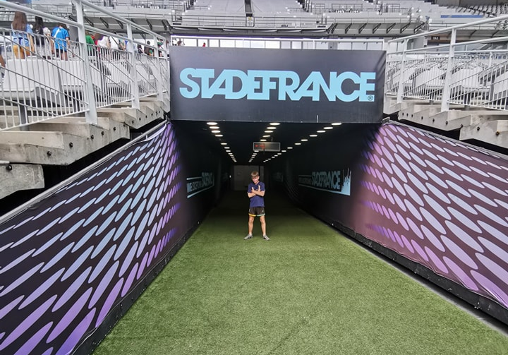

Slide 23
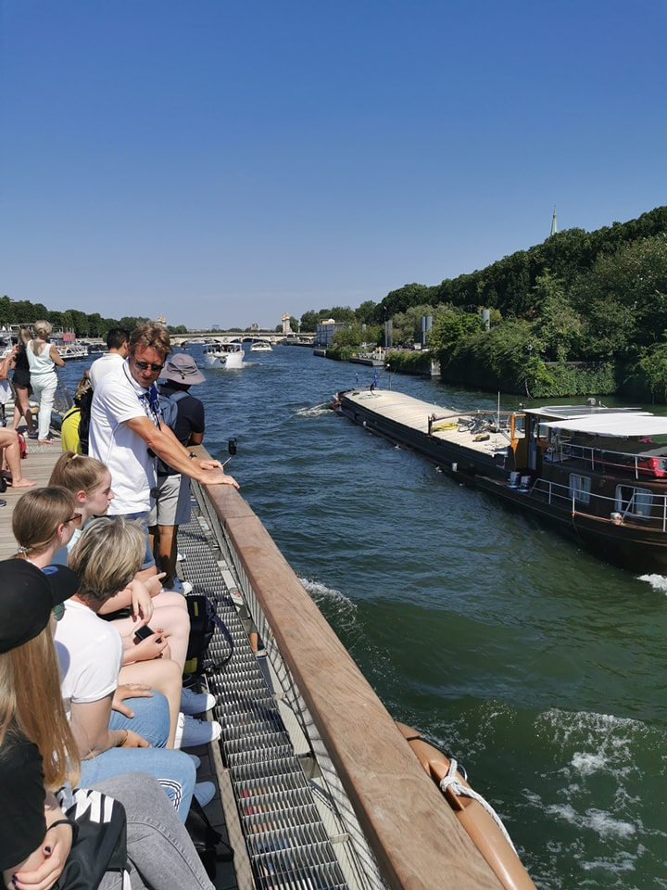
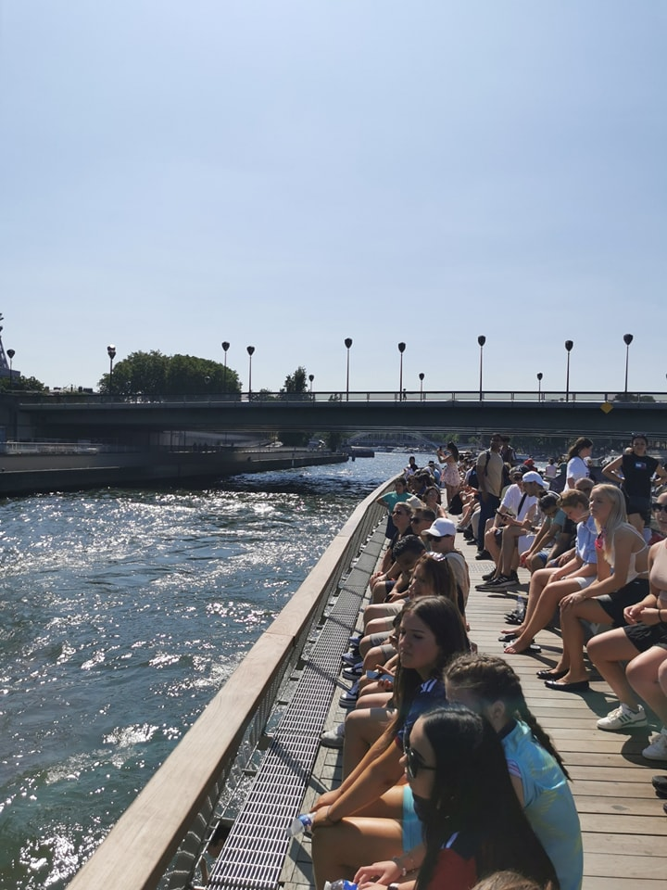

Slide 24
